Slide 1
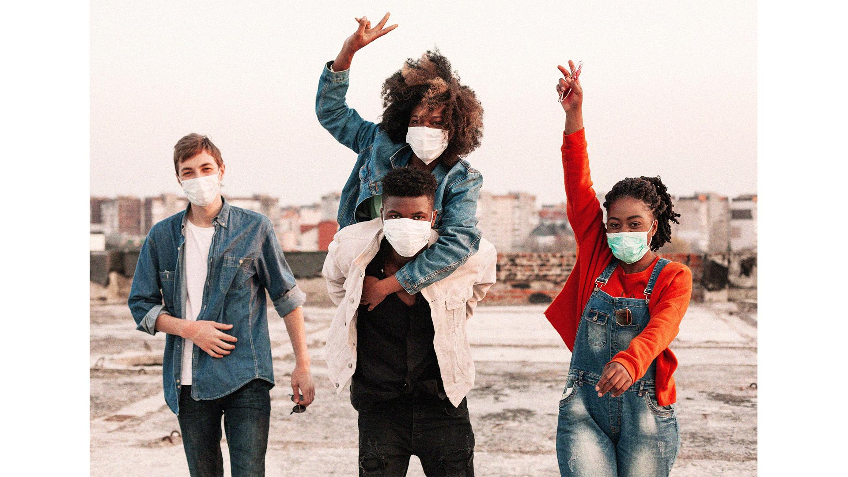
Predictive Modeling : Adolescent ALCOHOLism
SLIDESGO
SLIDESGO
HEALTH SUBJECT ALCOHOL TOBACCO & OTHER DRUGS // slidesgo
HEALTH SUBJECT ALCOHOL TOBACCO & OTHER DRUGS // slidesgo

Slide 2

Contents :
SLIDESGO
SLIDESGO
Background
Business Problem
Data problem
stakeholders
Data set
Analysis
Results
Recommenda-tions
Next steps
HEALTH SUBJECT ALCOHOL TOBACCO & OTHER DRUGS // slidesgo
HEALTH SUBJECT ALCOHOL TOBACCO & OTHER DRUGS // slidesgo

Slide 3

over 60% of 12 and 16
and more than 70% over 16
consume alcohol regularly
SLIDESGO
SLIDESGO
HEALTH SUBJECT ALCOHOL TOBACCO & OTHER DRUGS // slidesgo
HEALTH SUBJECT ALCOHOL TOBACCO & OTHER DRUGS // slidesgo
In Portugal

Slide 4
1. background
SLIDESGO
SLIDESGO
Alcohol is the most used psychoactive substance among adolescents. It is a major public health problem and health risk factor of this group.
It is also the main cause of road accidents, a leading cause of death among young people aged 16 to 20 years old.
Among countries within the European Union, Portugal is the one that has the highest alcohol consumption and Linked Alcohol Problems prevalence.
The consumption per capita was the highest in the world, standing in 2000 at 10.8 litres of pure alcohol, being the 3rd largest consumer.
HEALTH SUBJECT ALCOHOL TOBACCO & OTHER DRUGS // slidesgo
HEALTH SUBJECT ALCOHOL TOBACCO & OTHER DRUGS // slidesgo

Slide 5

TED Talk by Johann Hari about addiction
SLIDESGO
SLIDESGO
“What if addiction wasn’t about chemical hooks, what if it was about your cage? What if addiction is the adaptation to your environment?
If you are feeling isolated, traumatized, beaten down by life, you will bond with something that gives you a sense of relief such as gambling, alcohol, cocaine.
A core part of addiction is about not being able to bear to be present in your life.”
HEALTH SUBJECT ALCOHOL TOBACCO & OTHER DRUGS // slidesgo
HEALTH SUBJECT ALCOHOL TOBACCO & OTHER DRUGS // slidesgo

Slide 6

2. Business Problem
SLIDESGO
SLIDESGO
The Health Ministry recognizing the gravity of the situation wants to provide targeted social support to high-risk adolescents and has outsourced to private Data Analytics companies to come up with predictive models to tackle the problem. Your company has the winning bid to this project.
HEALTH SUBJECT ALCOHOL TOBACCO & OTHER DRUGS // slidesgo
HEALTH SUBJECT ALCOHOL TOBACCO & OTHER DRUGS // slidesgo

Slide 7

3. Data problem
SLIDESGO
SLIDESGO
HEALTH SUBJECT ALCOHOL TOBACCO & OTHER DRUGS // slidesgo
HEALTH SUBJECT ALCOHOL TOBACCO & OTHER DRUGS // slidesgo
As part of the consulting team:
With various info on adolescents’ school and home environment, design and build a data-driven model to identify individuals with high-risk alcohol consumption.

Slide 8
4. Stakeholders
SLIDESGO
SLIDESGO
a. Health ministry
c. Consulting team
HEALTH SUBJECT ALCOHOL TOBACCO & OTHER DRUGS // slidesgo
HEALTH SUBJECT ALCOHOL TOBACCO & OTHER DRUGS // slidesgo
b. Adolescents
d. Parents and teachers

Slide 9
5. Dataset
SLIDESGO
SLIDESGO
The dataset consists of 33 features described as follows :
2 Types of School, Gender, Age, Address
Family size, Parent’s cohabitation status
Mother’s and Father’s aducation, Mother’s and Father’s job
Reason for choosing the school, Student’s guardian
Travel time to school, Study time per week
Number of past class failures, Extra Educational Support, Family Education Support
Any extra paid classes for Math or Portuguese, Extra-Curricular Activities
Attended Nursery School, Plans for Higher Education, Internet Access
Romantic Relationship Status, Quality of Family Relationships, Free Time after School
Going Out with Friends, Weekday Alcohol Consumption, Weekend Alcohol Consumption
Current Health Status, School Absence, Grades 1,2,3
Total rows : 1,439
HEALTH SUBJECT ALCOHOL TOBACCO & OTHER DRUGS // slidesgo
HEALTH SUBJECT ALCOHOL TOBACCO & OTHER DRUGS // slidesgo

Slide 10

6. Predictive modeling
SLIDESGO
SLIDESGO
HEALTH SUBJECT ALCOHOL TOBACCO & OTHER DRUGS // slidesgo
HEALTH SUBJECT ALCOHOL TOBACCO & OTHER DRUGS // slidesgo

Slide 11
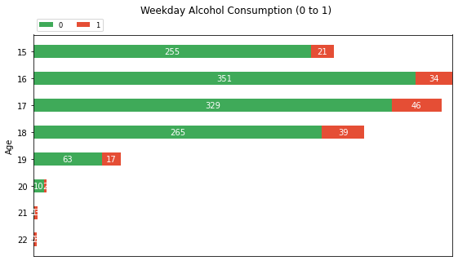
6. Predictive Analysis : Weekday vs. weekend alcohol consumption
SLIDESGO
SLIDESGO
HEALTH SUBJECT ALCOHOL TOBACCO & OTHER DRUGS // slidesgo
HEALTH SUBJECT ALCOHOL TOBACCO & OTHER DRUGS // slidesgo
Minimal Weekday Alcohol Consumption

Slide 12
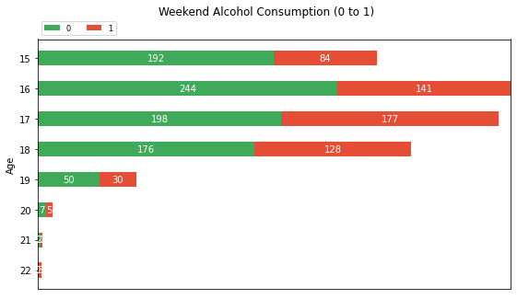
6. Predictive Analysis : Weekday vs. weekend alcohol consumption
SLIDESGO
SLIDESGO
HEALTH SUBJECT ALCOHOL TOBACCO & OTHER DRUGS // slidesgo
HEALTH SUBJECT ALCOHOL TOBACCO & OTHER DRUGS // slidesgo
Higher Alcohol Consumption on Weekends

Slide 13
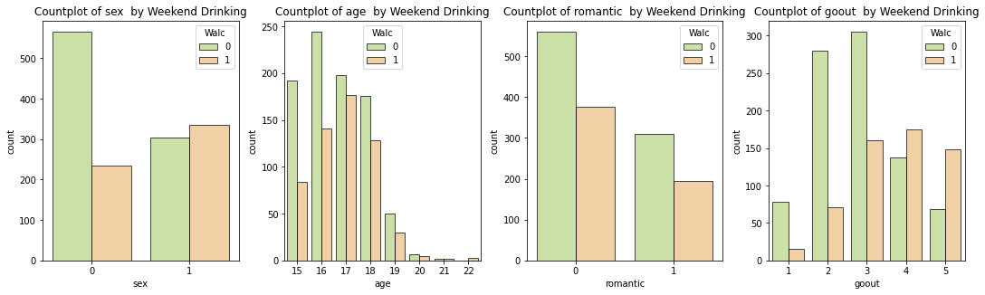
6. Predictive Analysis : weekend alcohol consumption
SLIDESGO
SLIDESGO
HEALTH SUBJECT ALCOHOL TOBACCO & OTHER DRUGS // slidesgo
HEALTH SUBJECT ALCOHOL TOBACCO & OTHER DRUGS // slidesgo

Slide 14
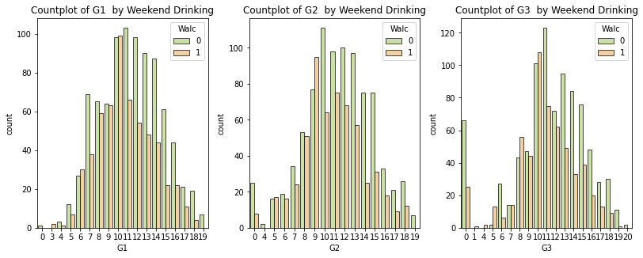
6. Predictive Analysis : weekend alcohol consumption
SLIDESGO
SLIDESGO
HEALTH SUBJECT ALCOHOL TOBACCO & OTHER DRUGS // slidesgo
HEALTH SUBJECT ALCOHOL TOBACCO & OTHER DRUGS // slidesgo

Slide 15
7. Results – classification report
SLIDESGO
SLIDESGO
no | Classifiers | accuracy | precision | recall | F1-score
1 | k-Nearest Neighbors | 90% | 90% | 90% | 90%
2 | Support Vector Machines | 89% | 90% | 88% | 89%
3 | One Vs Rest | 82% | 85% | 79% | 81%
HEALTH SUBJECT ALCOHOL TOBACCO & OTHER DRUGS // slidesgo
HEALTH SUBJECT ALCOHOL TOBACCO & OTHER DRUGS // slidesgo

Slide 16
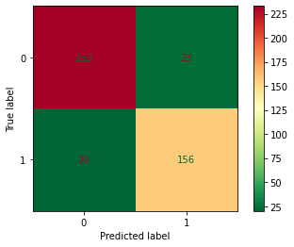
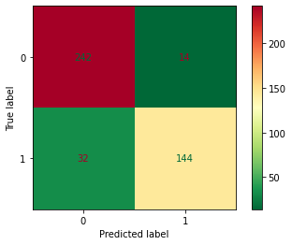
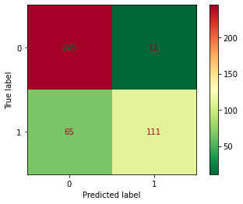
7. Results – confusion matrix
KNN
SVM
OvR
SLIDESGO
SLIDESGO
HEALTH SUBJECT ALCOHOL TOBACCO & OTHER DRUGS // slidesgo
HEALTH SUBJECT ALCOHOL TOBACCO & OTHER DRUGS // slidesgo

Slide 17
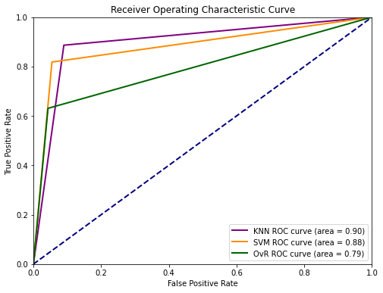
7. Results – ROC
The higher the better the performance of the model at distinguishing between the positive and negative classes.
SLIDESGO
SLIDESGO
HEALTH SUBJECT ALCOHOL TOBACCO & OTHER DRUGS // slidesgo
HEALTH SUBJECT ALCOHOL TOBACCO & OTHER DRUGS // slidesgo

Slide 18

8. Recommendations
01.
02.
deployment
monitor
03.
04.
End-user
Real time
SLIDESGO
SLIDESGO
Staggered deployment before final rollout
To monitor performance of the model for finetuning
HEALTH SUBJECT ALCOHOL TOBACCO & OTHER DRUGS // slidesgo
HEALTH SUBJECT ALCOHOL TOBACCO & OTHER DRUGS // slidesgo
Appropriate format
Instead of historical data

Slide 19
9. Next steps
1. Additional data
3. Ensemble methods
2. Feature selection
SLIDESGO
SLIDESGO
HEALTH SUBJECT ALCOHOL TOBACCO & OTHER DRUGS // slidesgo
HEALTH SUBJECT ALCOHOL TOBACCO & OTHER DRUGS // slidesgo
Such as Bagging and Boosting
From all other classes other than Maths and Portuguese
And from other Schools
With the additional datas

Slide 20


thanks!
SLIDESGO
SLIDESGO
HEALTH SUBJECT ALCOHOL TOBACCO & OTHER DRUGS // slidesgo
HEALTH SUBJECT ALCOHOL TOBACCO & OTHER DRUGS // slidesgo
Do you have any questions?

